Slide 1
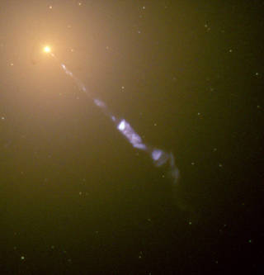
Shaping Jets with the Ambient Medium
Max Paik
Tchekhovskoy Group
Northwestern University
Collaborators:
Valeriia Rohoza, Aris Lalakos, Koushik Chatterjee, Matthew Liska
This research was in part funded by the Illinois Space Grant.
The study resulting in this presentation was assisted by a grant from the Baker Program in Undergraduate Research, which is administered by Northwestern University's Weinberg College of Arts and Sciences. However, the conclusions, opinions, and other statements in this presentation are the author's and not necessarily those of the sponsoring institution.
Credit: NASA and the Hubble Heritage Team
Notes:
Hi, I’m Max Paik from Northwestern University. And I’ve been working with the Tchekhovskoy group to research the development of jets in ambient media.
On the bottom half of this slide, you can see an image of the jet emanating the supermassive blackhole at the center of M87.
The yellow region represents the supermassive blackhole and the blue is a jet.
This is a beautiful image, but it is a bit hard to see in detail, so we will look at a mockup to understand the components of the system.

Slide 2
Jets = highly energetic outflows
Transition from parabolic to conical expansion
Gravitational radius (R_{g})
Black hole
(~ 10⁶-10¹⁰ M⊙)
Jet
Accretion disk
Bondi radius:
R_{B} ~ 10⁵-10⁶ R_{g} ~ 10¹-10² pc
Ambient medium
How does the surrounding environment shape these jets?
Max Paik
Notes:
So, generally speaking, jets are highly energetic outflows launched from black holes. And because they are of such high energy, their development can have large affects on the entire galaxy.
The characteristic unit of length is the Gravitational Radius, Rg.
And this is a sort of typical diagram of a jet system. You can see a black hole in the center as the black circle, which for supermassive black holes is of about 10^6 to 10^10 solar masses. Its gravity pulls in matter in an accretion disk, shown in red. One other important length to consider is the Bondi Radius, which is the distance at which the thermal pressure of the gas begins to overcome the gravity of the black hole. And note the vast scale separation inherent to this problem.
So as matter is accreted, magnetic fields get pulled in and a jet can be launched. This is shown in blue. The parameter we are most interested in for the rest of this talk is the shape the jet takes on as it propagates. In particular, you can see a fairly standard image here where the jet at first expands parabolically then transitions to conical expansion. This conical expansion is associated with very strong, powerful jets that are able to enter a free expansion regime.
In real systems, the jet interacts with the surrounding gas, or ambient medium as it moves outward. The core question of this talk is how can the ambient medium shape the jet. We can begin by asking what is observed in real systems.

Slide 3
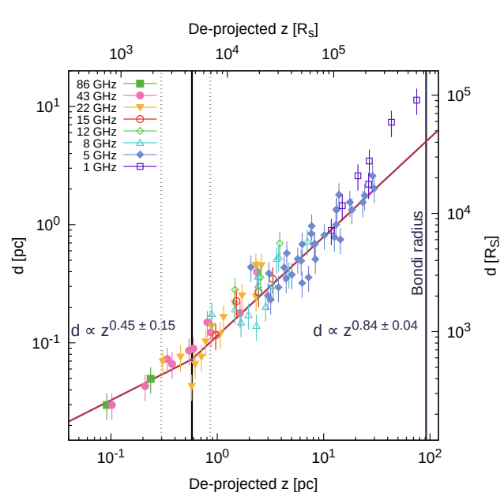
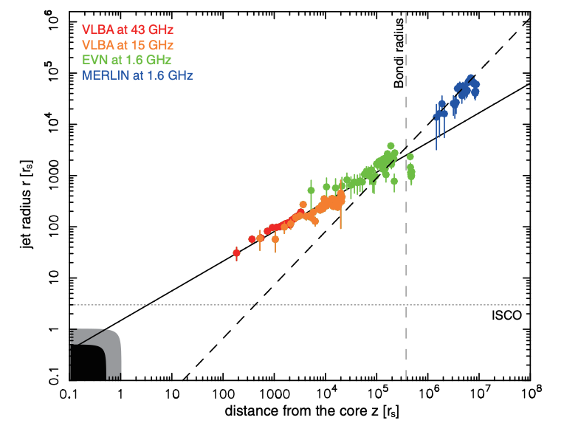
Observations show jet regime changes
Parabolic to conical transitions common in AGN Kovalev, et al. (2020)
M87
NGC 315
Asada and Nakamura (2012)
Boccardi, et al. (2021)
Max Paik
Transitions inside and out to R_{B}
Notes:
So here you can see an observation of M87. On the x axis is distance along the jet, which you can think of as the z direction. On the y axis is the width of the jet. This is a log log plot so power laws are linear. And we see something super exciting, the jet transitions from a shallower, roughly parabolic profile to a steeper, conical one just inside the Bondi Radius.
This observation is not isolated. You can see something similar in NGC 315 except this time the transition happens well inside the Bondi Radius. It turns out that this parabolic to conical transition has been seen in ten nearby Active Galactic Nuclei.
So, the question becomes what conditions might lead to this type of transition?

Slide 4
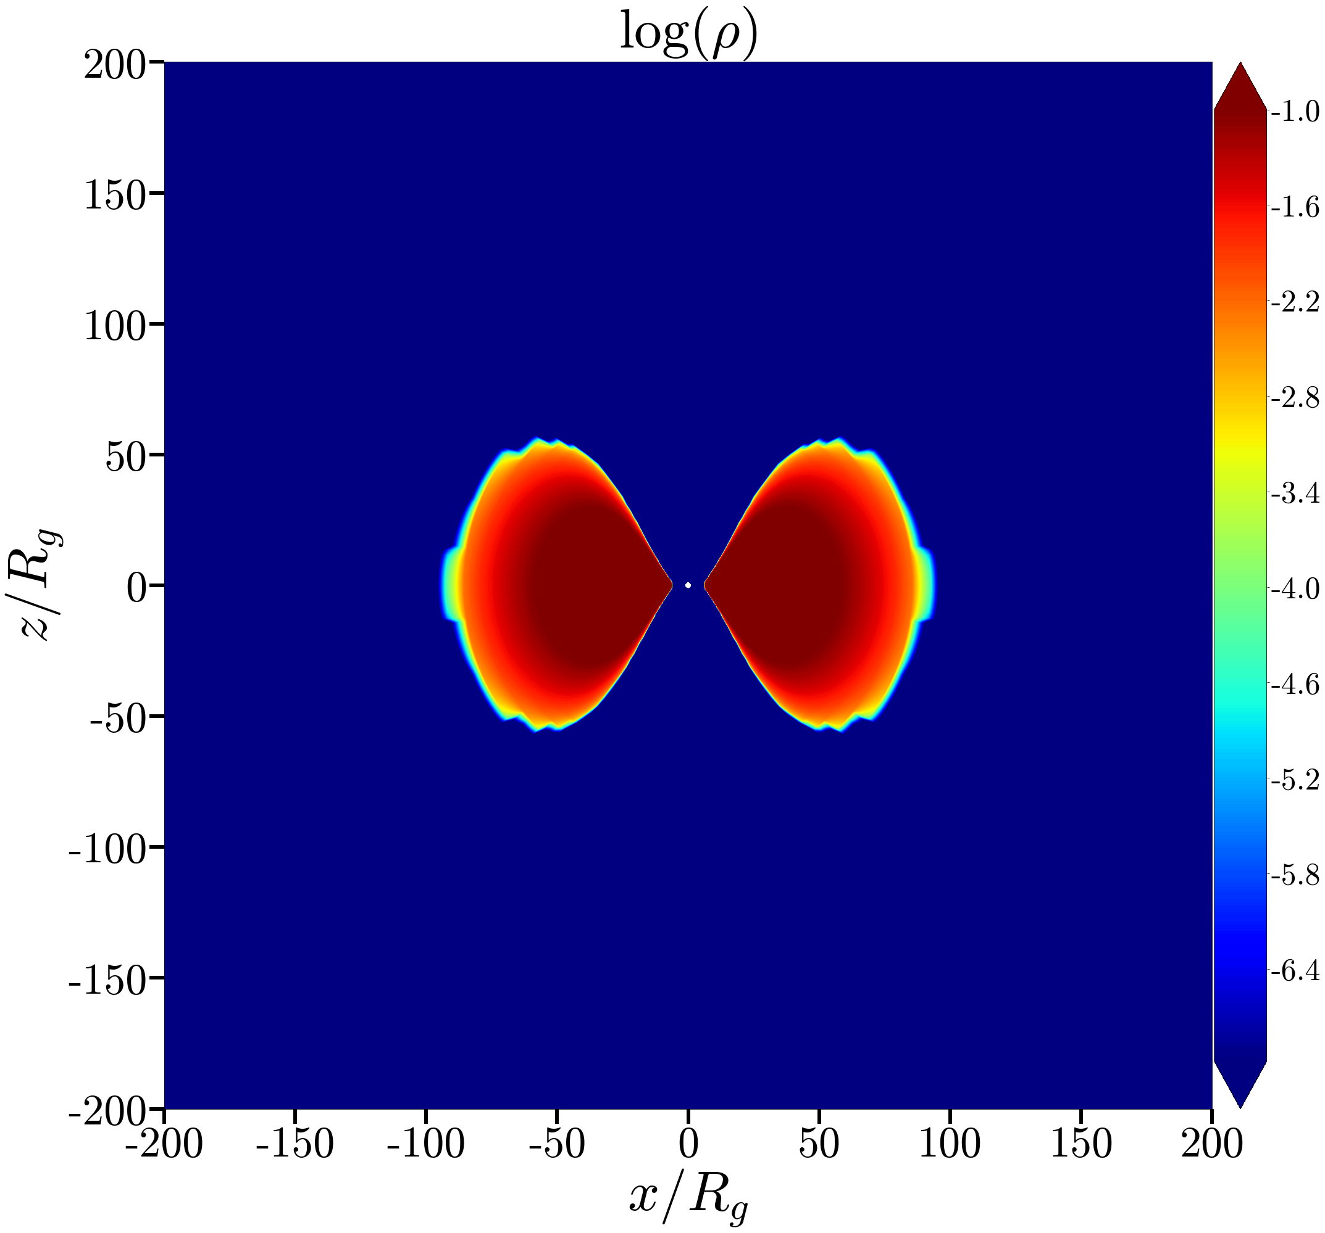
Cutting-edge numerical simulation
No Ambient Medium
GPU-accelerated, 3D General Relativistic Magnetohydrodynamic code, HAMR
Magnetized torus launches powerful jets
Liska, et al. (2019)
Max Paik
Notes:
Well, unfortunately you cannot put a black hole in a lab, so in order to answer that question we turn to numerical simulations.
In particular, I use the 3D general relativistic magnetohydrodynamic code HAMR to simulate these systems. On the right you can see a XZ cross section of a colormap of density in a fairly typical simulation setup. A magnetized torus is initialized so that as time moves forward matter is accreted and consistent/powerful jets are launched. In this sort of basic setup, the jet propagates through a vacuum.
So what does this look like at late time after the jet is launched?

Slide 5
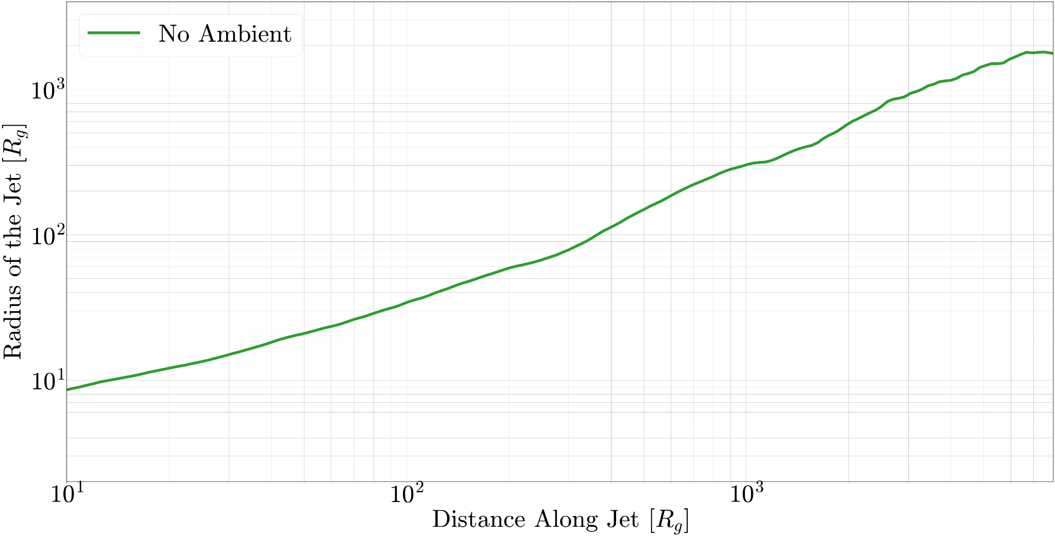
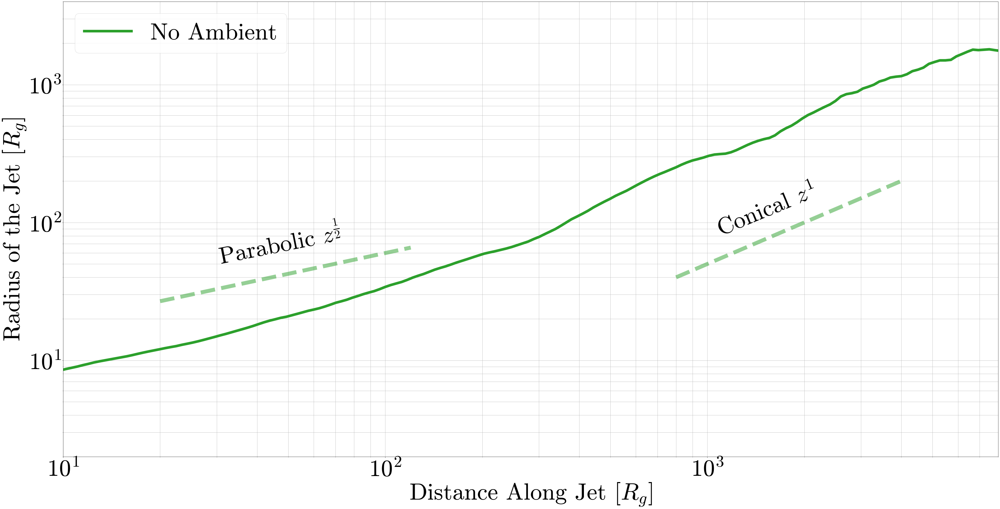
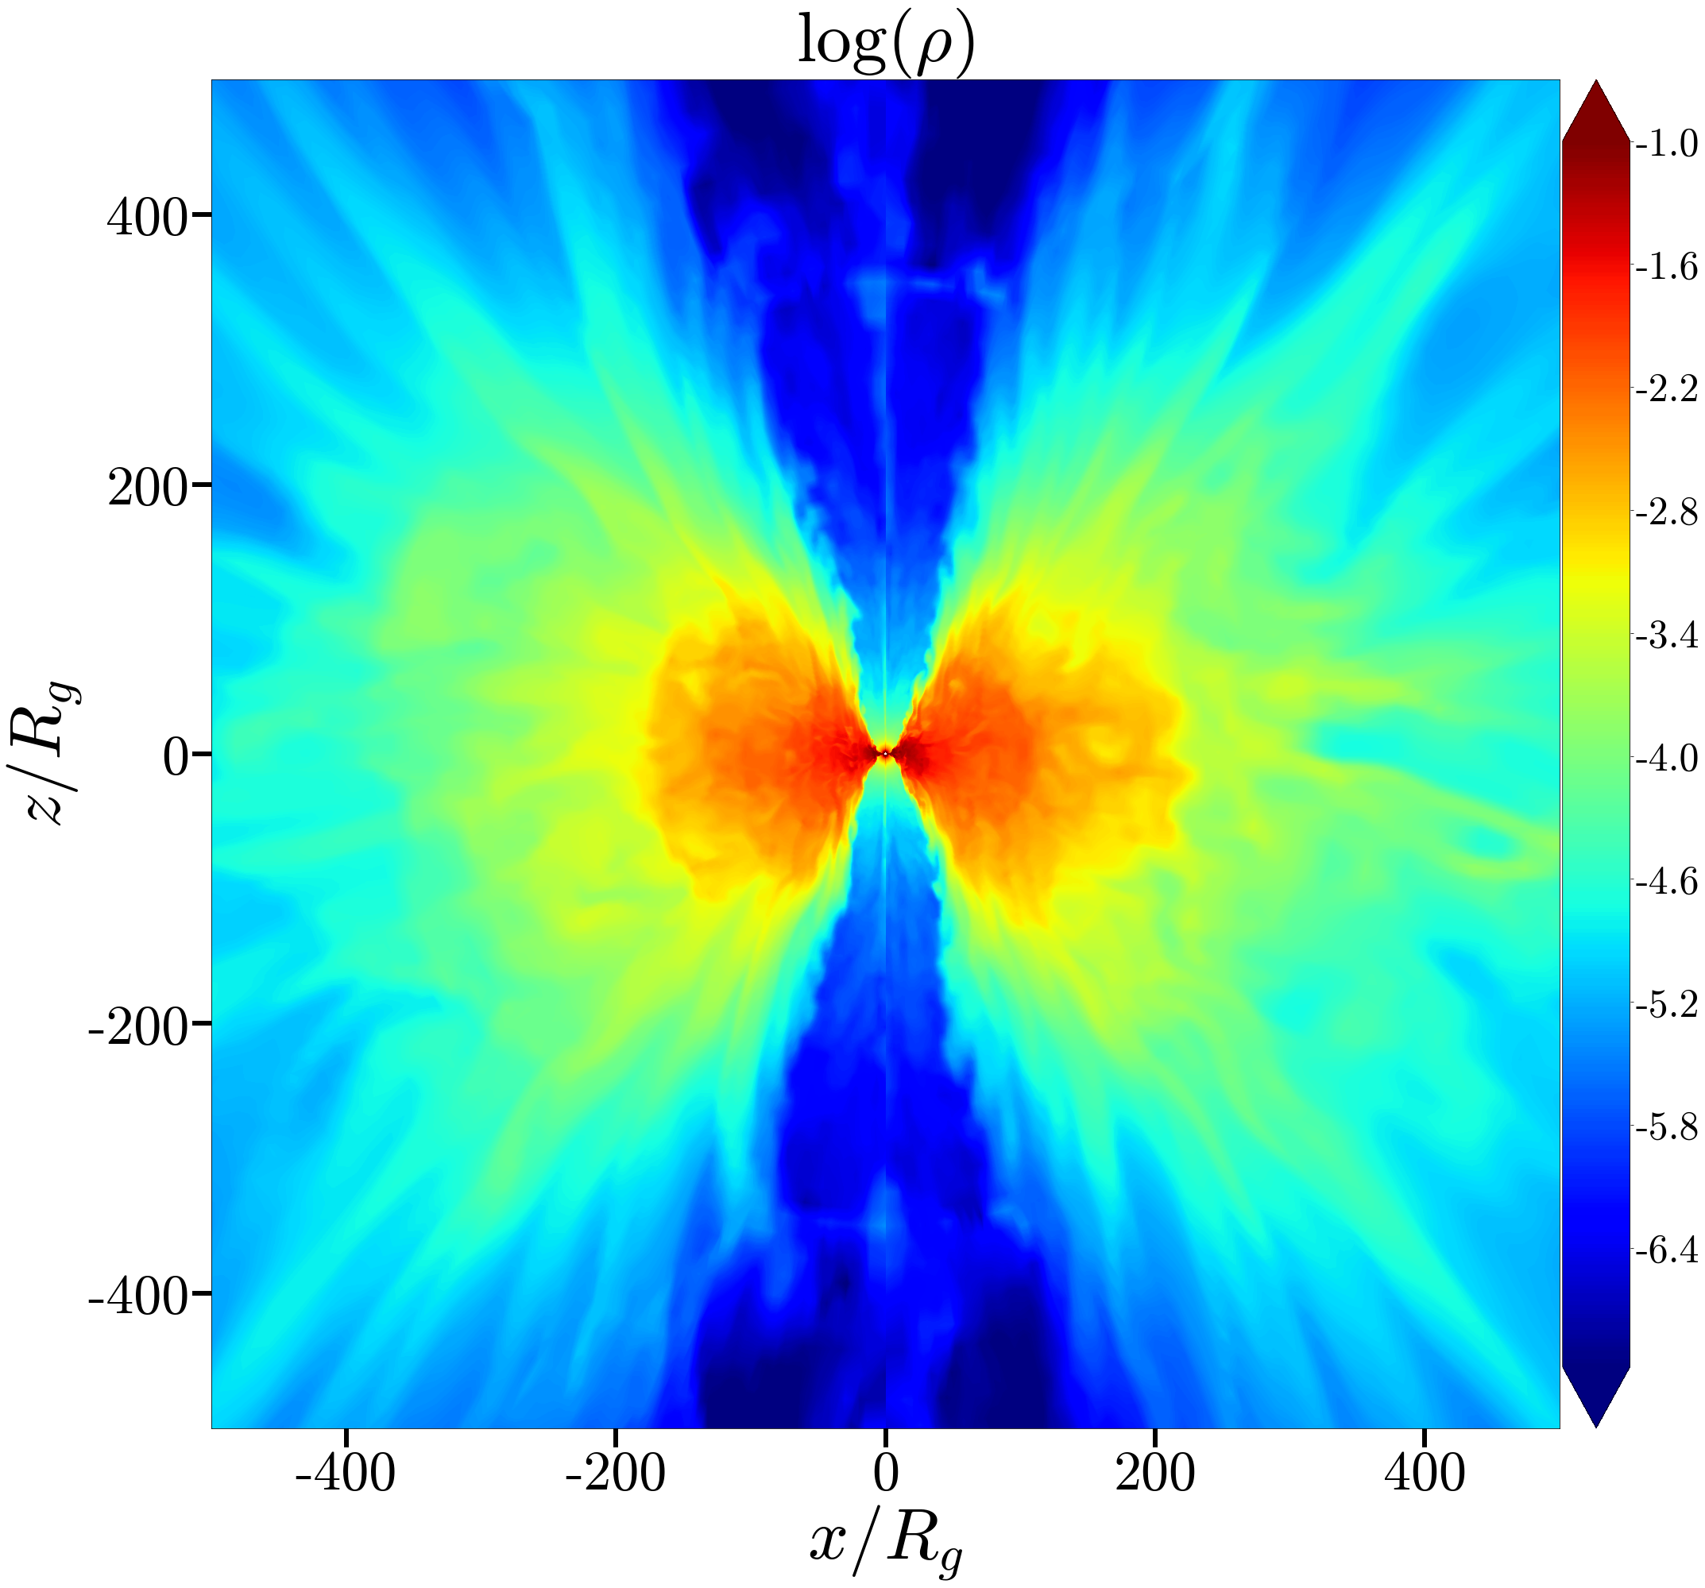
Disk winds create funnel near black hole
No Ambient Medium
Pressure balance between disk and jet creates parabolic profile
Max Paik
Notes:
Well you can see another cross section of density. The high density red regions correspond with the accretion disk. The low density blue regions are jets. And if you examine the jet shape you can see that near the black hole it is parabolic and at further distances it is conical.
This may seem like exactly what we were searching for. However, what is dictating this shape is the pressure balance of the disk’s thermal pressure and the magnetic pressure In the jet. Once the jet escapes the winds off the disk, it becomes conical. This disk is a somewhat unrealistic setup, since jets don’t propagate through a vacuum and the torus is part of the initial condition used to launched jets. So we want to consider systems that are a bit more organic.

Slide 6
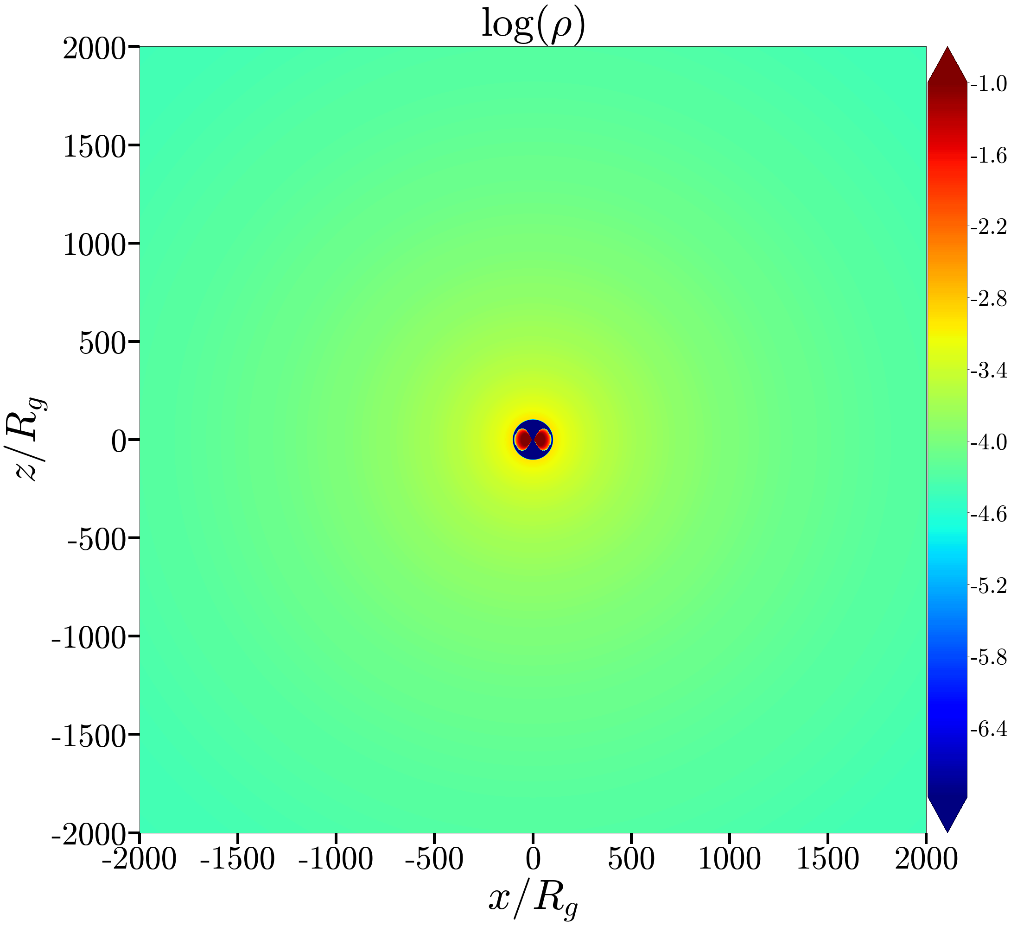
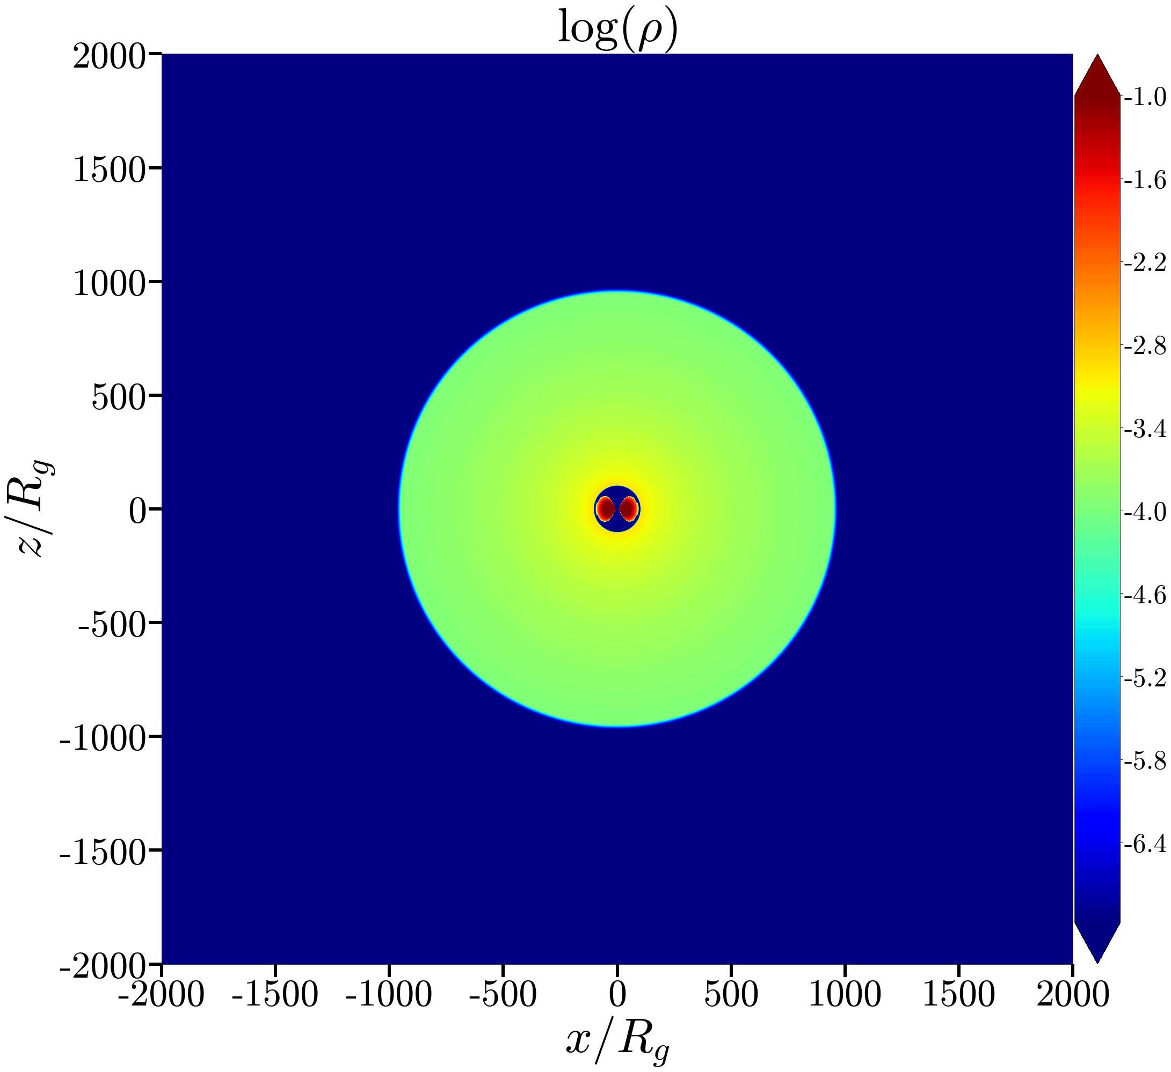
Probing effects of the ambient medium
Infinite Ambient Medium
Cutoff Ambient Medium
R_{B} = 100 R_{g}
⍴ ~ 0, 10³ R_{g} < r
⍴ ~ r ⁻¹, 10² R_{g} < r
⍴ ~ r ⁻¹, 10² R_{g} < r < 10³ R_{g}
Max Paik
Notes:
In order to do this, we place the same torus as before inside some surrounding gas, or ambient medium). On the left you see the first setup in which the density falls off according to 1/r and extends to infinity. The Bondi Radius is set to be 100 Rg. Note that we have scaled down the problem significantly for computational reasons. On the right we have the same setup within 1000 rg, but at 1000 rg the density falls of sharply to zero. You can think of this like the edge of a galaxy or just a transition point in the ambient medium. I will refer to these setups as infinite and cutoff, respectively.
In each case, note that the jet may encounter less resistance as it moves outward, which may allow for transitions in profile.
We can now see what these simulations look like.

Slide 7
Infinite Ambient Medium
Cutoff Ambient Medium
Max Paik
Notes:
In the infinite case, you can see that jets are launched and they very quickly start getting turned around in to backflows, like a squirt gun hitting a wall. These backflows extend far back. Together with the ambient gas, they provide pressure that prevents this jet from expanding. In fact, you can see it looks almost cylindrical.
In the cutoff case, the jet looks similar at first. Again, it starts getting turned around. However, once it reaches the density cutoff, the story changes drastically. The jet no longer has inward pressure from the ambient medium or backflows and so it is able to expand strongly and quickly.
It can even be a bit tough to see the full difference here since jets are low density.

Slide 8
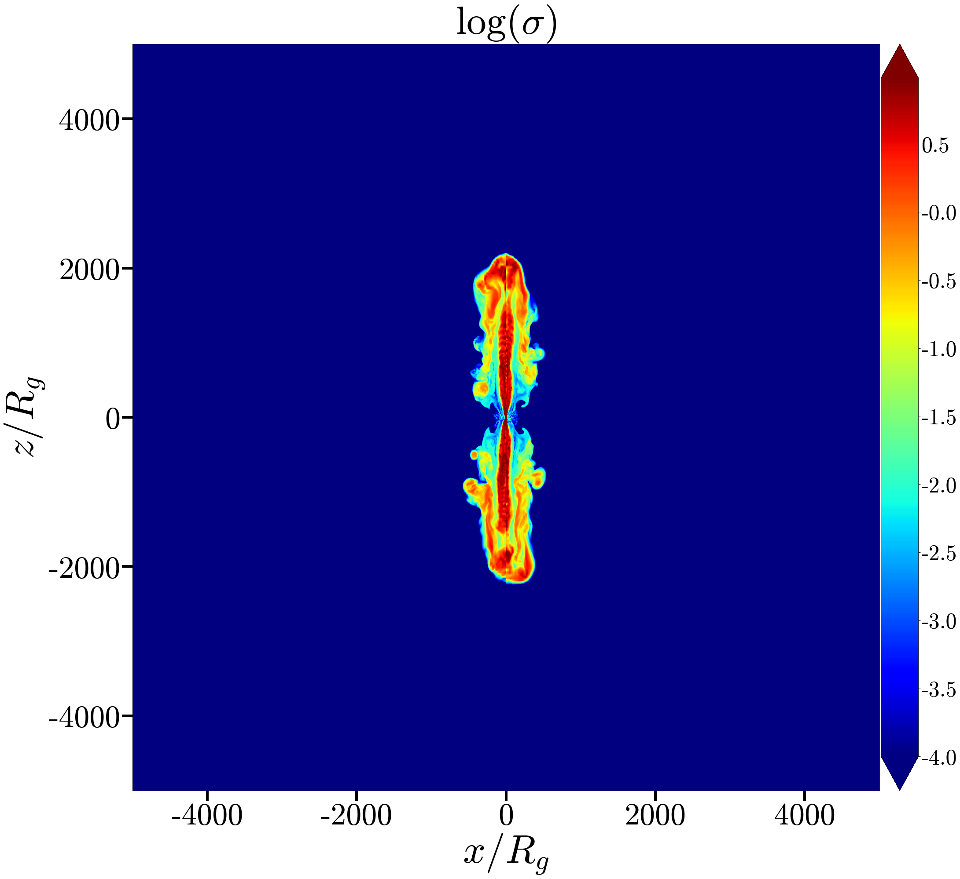
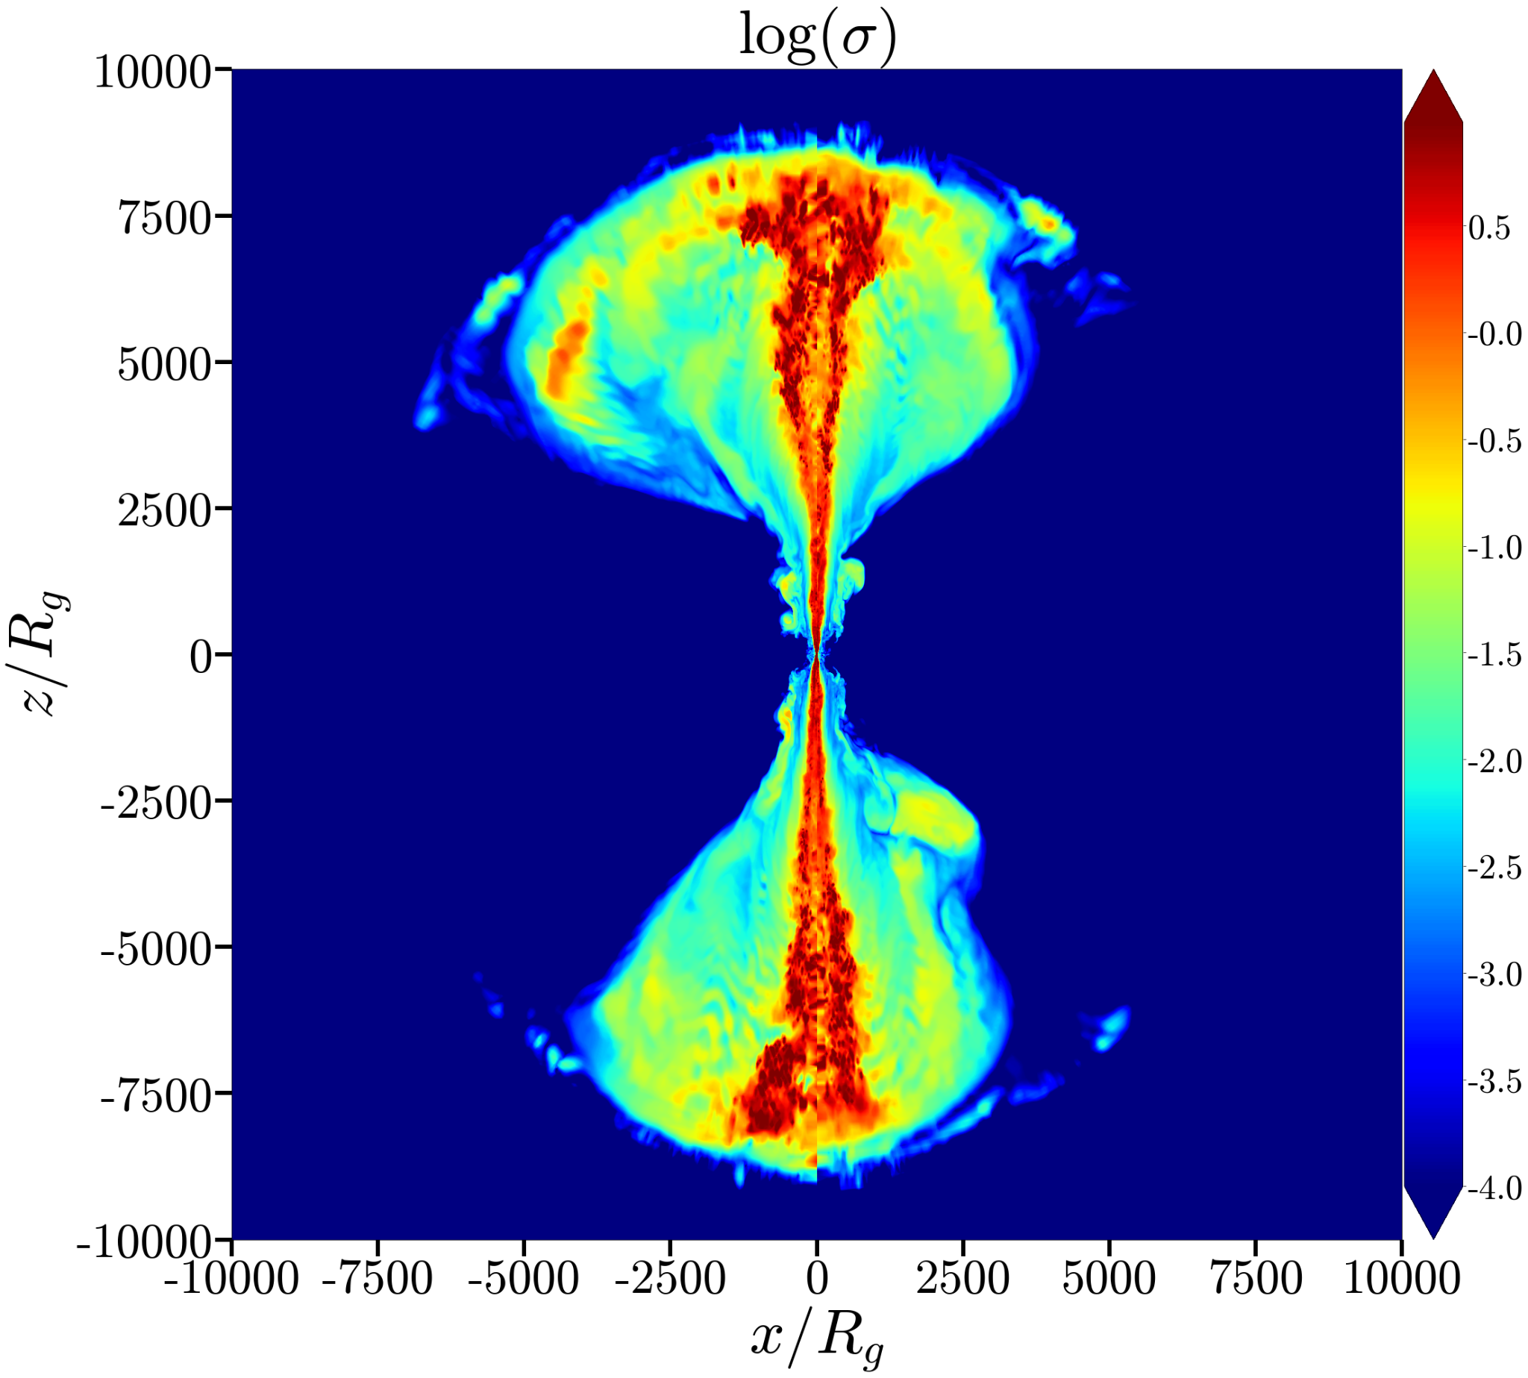
Rapid expansion of magnetization
Infinite Ambient Medium
Cutoff Ambient Medium
Conical expansion
Max Paik
Notes:
So with that in mind it is helpful to look at colormaps sigma, or the magnetization, since jets are highly magnetized. Note that the infinite case is very tightly collimated, whereas the cutoff jet has a very wide, conical structure. It is also worth noting that zoomed out the jet looks entirely conical, and some of the transitions which we will soon see are occurring much closer to the black hole.
In order to more robustly consider jet shape, we turn to the plots we saw earlier when we were looking at observations.

Slide 9
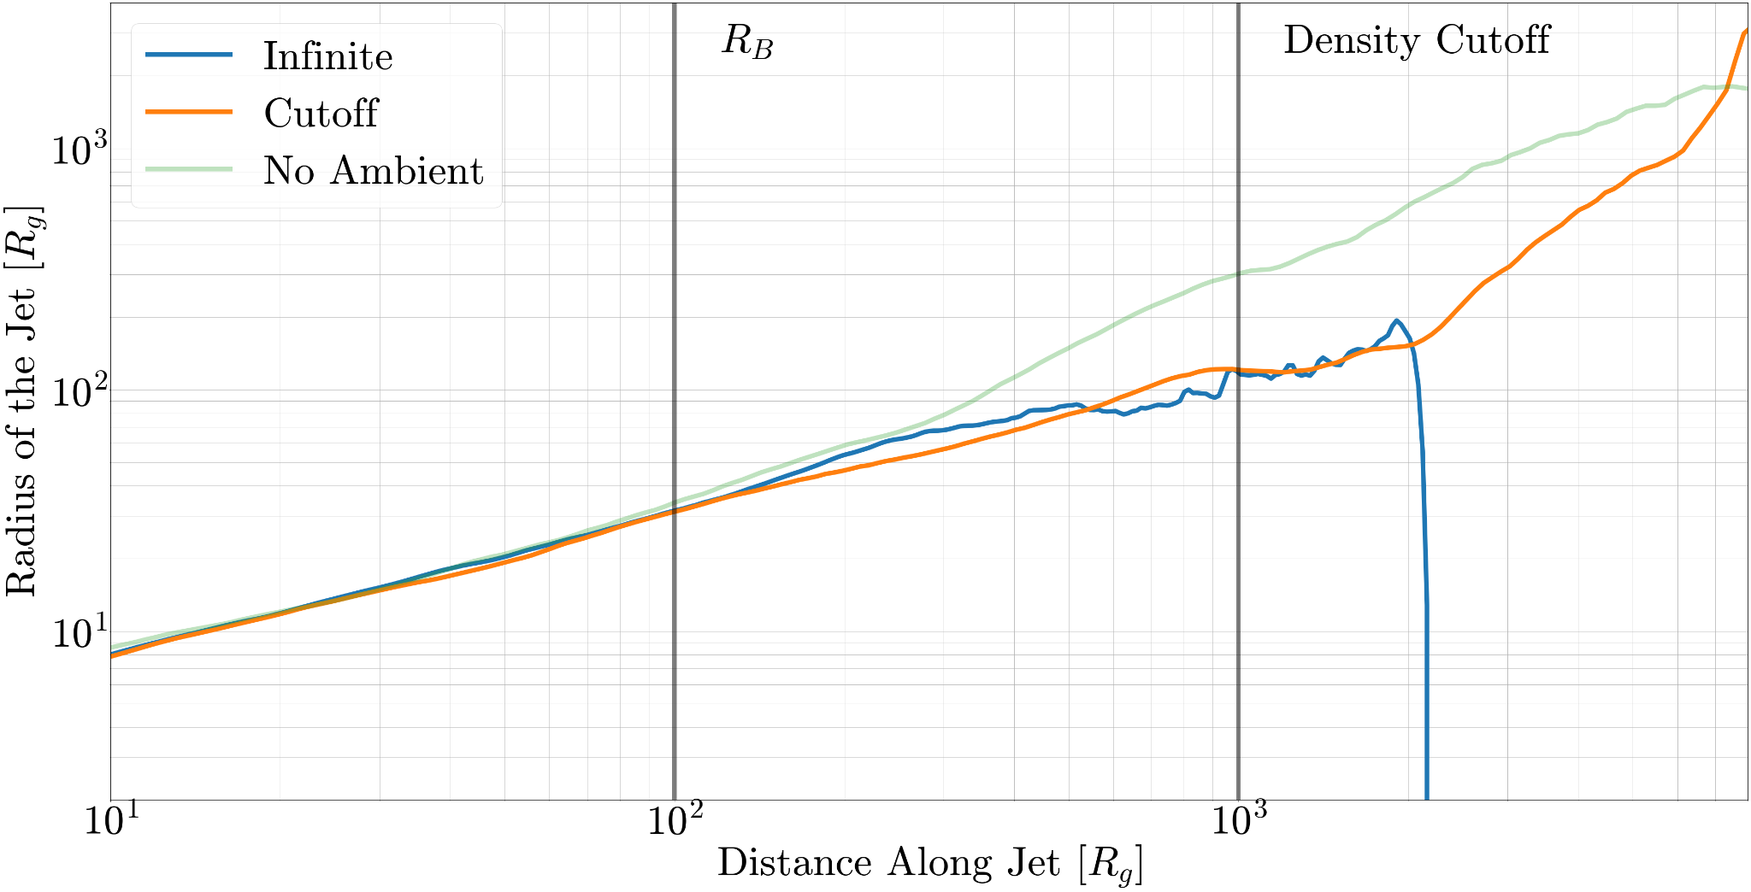
Jet shape in simulations
Max Paik
Notes:
So here you see the same plot, with the infinite condition in blue, the cutoff in orange, and the case with no ambient medium in a soft green. Again this is a log log plot of jet width vs distance along the jet. In addition, you can see vertical lines corresponding to the Bondi Radius and density cutoff. Let’s look at these one by one.

Slide 10
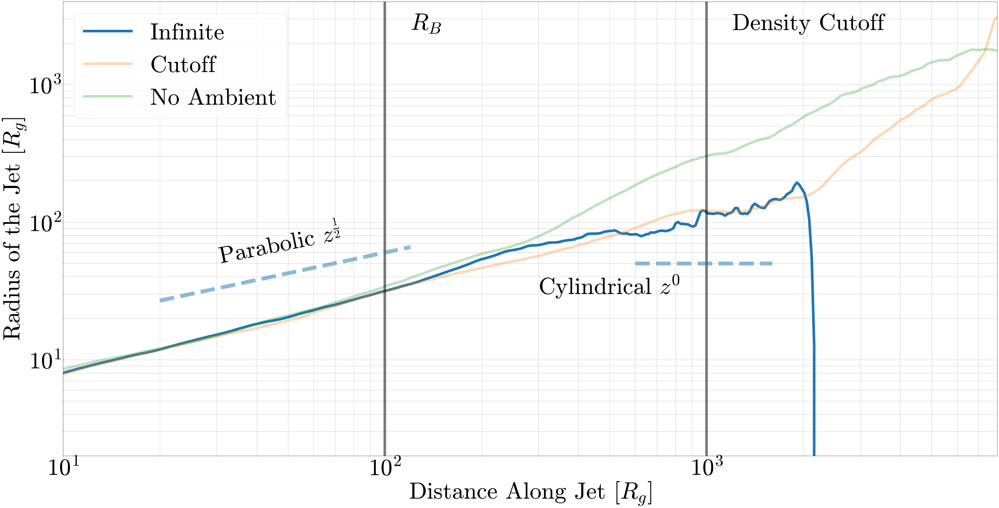
Infinite medium creates cylindrical jets
Max Paik
Notes:
The Infinite medium at first expands roughly parabolically, similar to the run with no ambient medium where the disk shapes the jet into a parabola. However, a bit past the Bondi Radius the thermal pressure of the gas begins collimating the jet into a cylinder, and you can see this in the region where the blue curve starts to roughly flatten out. And this is really interesting to see as it remains fairly consistent until the end of the jet, which corresponds with the vertical blue line. We also see that jets that encounter changes in their surroundings can have clear regime changes.

Slide 11
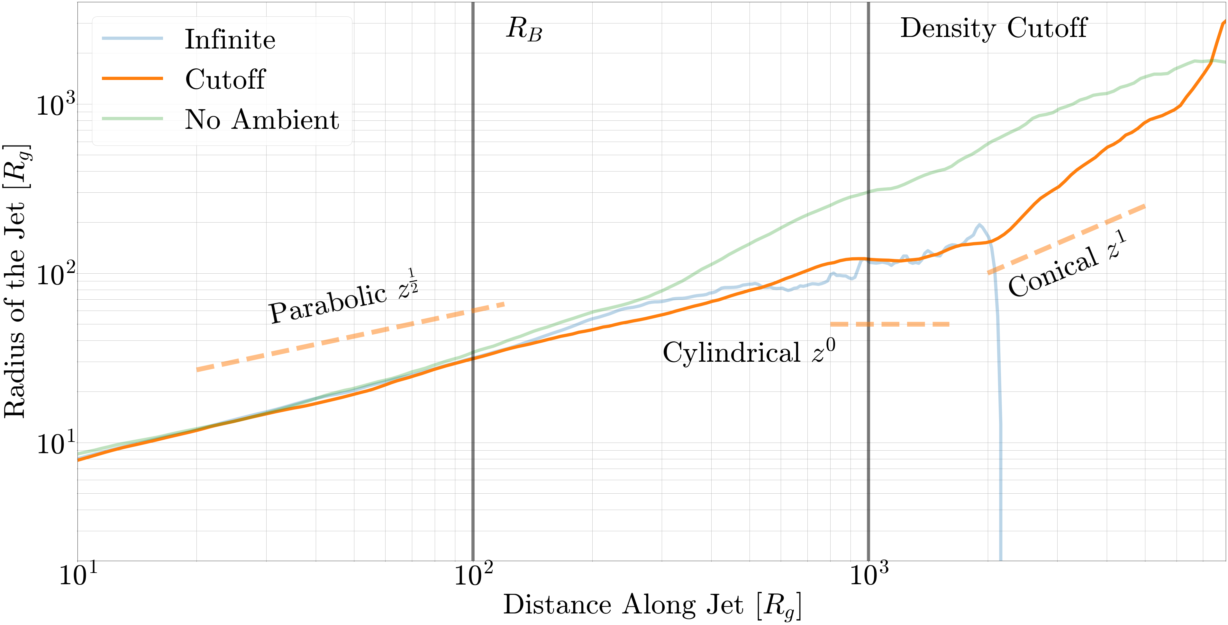
Jet regime changes drastically near cutoff
Max Paik
Notes:
In the simulation here with the cutoff, at first we see something similar. The jet even again enters a brief cylindrical regime while it moves through the medium. However, upon escaping from the high density gas, the jet explodes and starts expanding roughly conically. Thus we see that a jet can be collimated by surrounding material before entering a conical, free expansion regime upon exiting the area where that material dominates. Again we see that changes in the ambient medium also lead to corresponding regime changes in the jet.

Slide 12
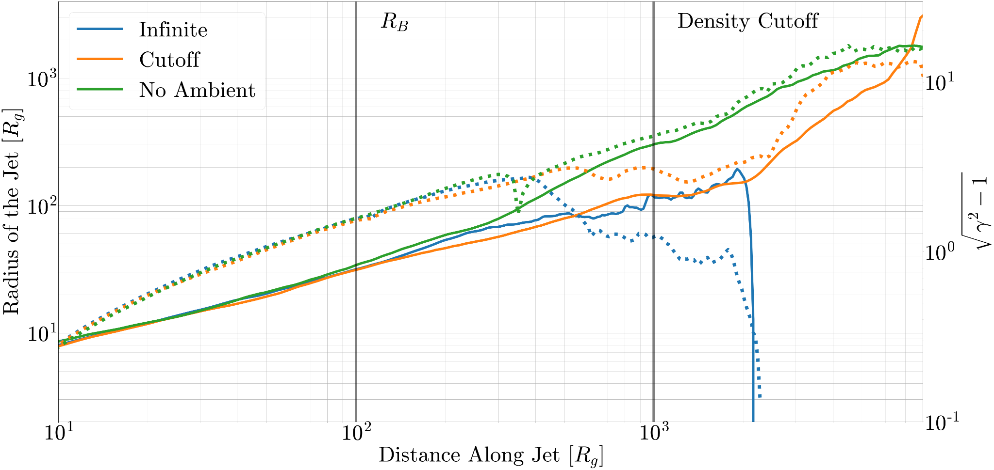
Expanding jets speed up
Max Paik
Notes:
And just to sort of time everything together, we can add in the dashed lines the proper velocity of the jet (square root of gamma squared – 1). We will see in this plot that the shape of the jet is not an isolated parameter, instead it tells us a lot about the system in general.
We can again see that within the Bondi Radius all three setups appear pretty similar, and this corresponds to the region where the winds of the disk/torus are dominating. However, as the jets meet their ambient mediums we see different behavior. When the jets run into the ambient medium, which you can see in orange and blue, they begin slowing down as the have to fight against the external pressure. This corresponds with the cylindrical regimes. However, when the jet in the cutoff simulation escapes the ambient medium, it not only expands but also speeds up sharply until it reaches velocities comparable to the jet which never encountered an ambient medium.

Slide 13
Takeaways
Disk winds shape jet into a parabola near the black hole.
A r ⁻¹ ambient density profile can provide sufficient pressure to collimate jets into cylinders.
Escaping regions of higher density allows for transition to a conical free expansion regime.
Future work:
larger scale separations
different ambient medium profiles
Contact: maxpaik2023@u.northwestern.edu
Max Paik
Notes:
So to summarize:
We see that ambient density profiles provide thermal pressure that collimates jets and that changes in the ambient medium can allow for transitions in the jet’s profile. A 1/r profile is capable of shaping a jet into a cylinder.
In addition, we see that jets that escape regions of higher density are able to expand conically and enter relativistic free expansion regimes.
In the future there are a lot of interesting places to take this project. It would of course be interesting to examine larger scale separations that are closer to observations.
In addition, the infinite and cutoff simulations represent two extreme cases in which we saw extreme behavior of the jet. Playing with more ambient medium profiles and more completely examining the space will be quite interesting.
Finally, we saw that all three simulations behaved roughly the same even a bit past the Bondi Radius in the region where effects from the disk dominate. Because observations showed transitions inside the Bondi Radius, setting up runs with self-consistent accretion instead of the initial torus may be interesting as well.
Thank you for your time and please let me know if you have questions ☺

Slide 14
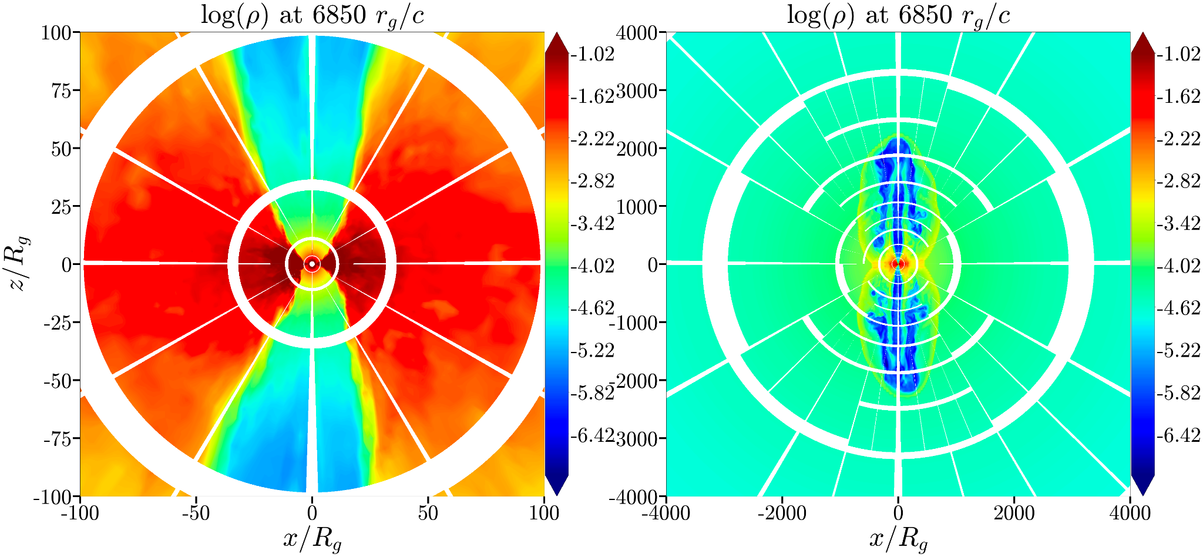
Resolving jets at large scale separation
Base grid is (640 x 288 x 288) in spherical coordinates
Adaptive Mesh Refinement allows jet to be resolved at large distances
Max Paik

Slide 15
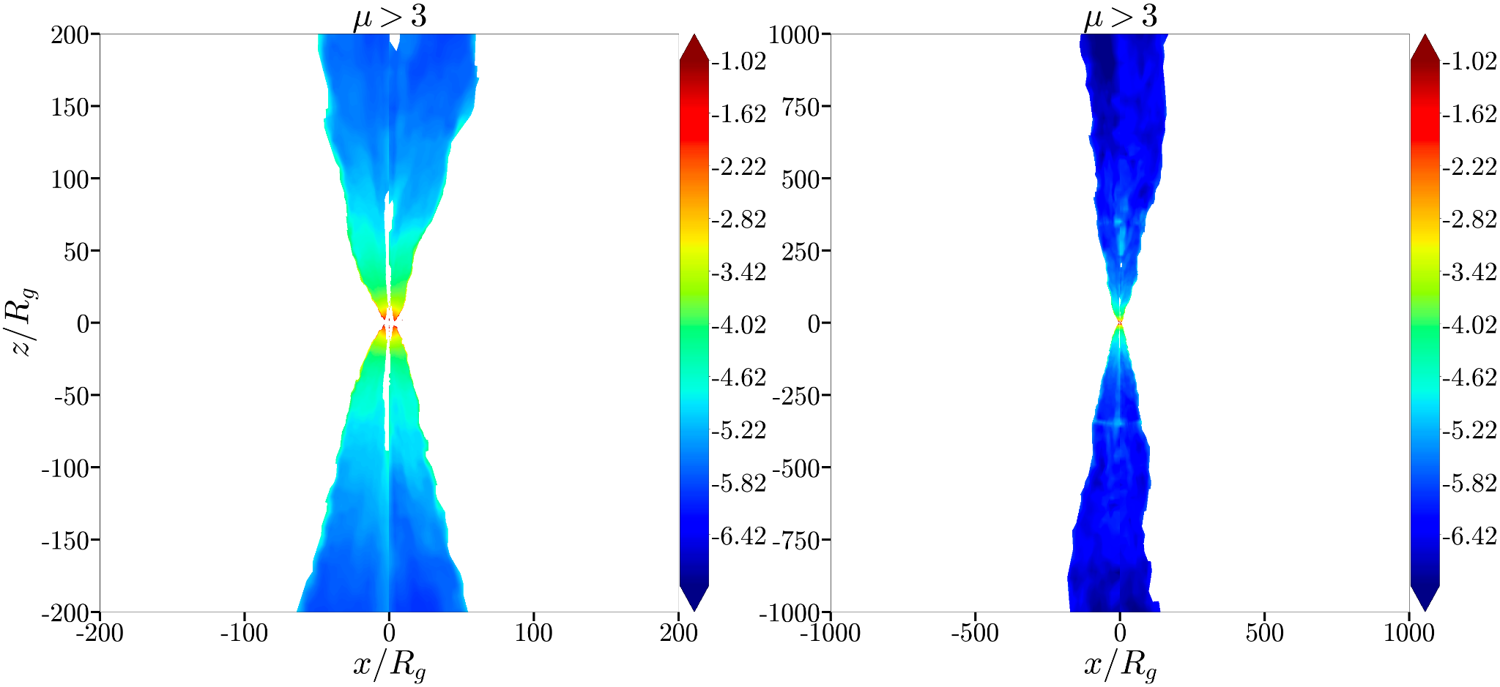
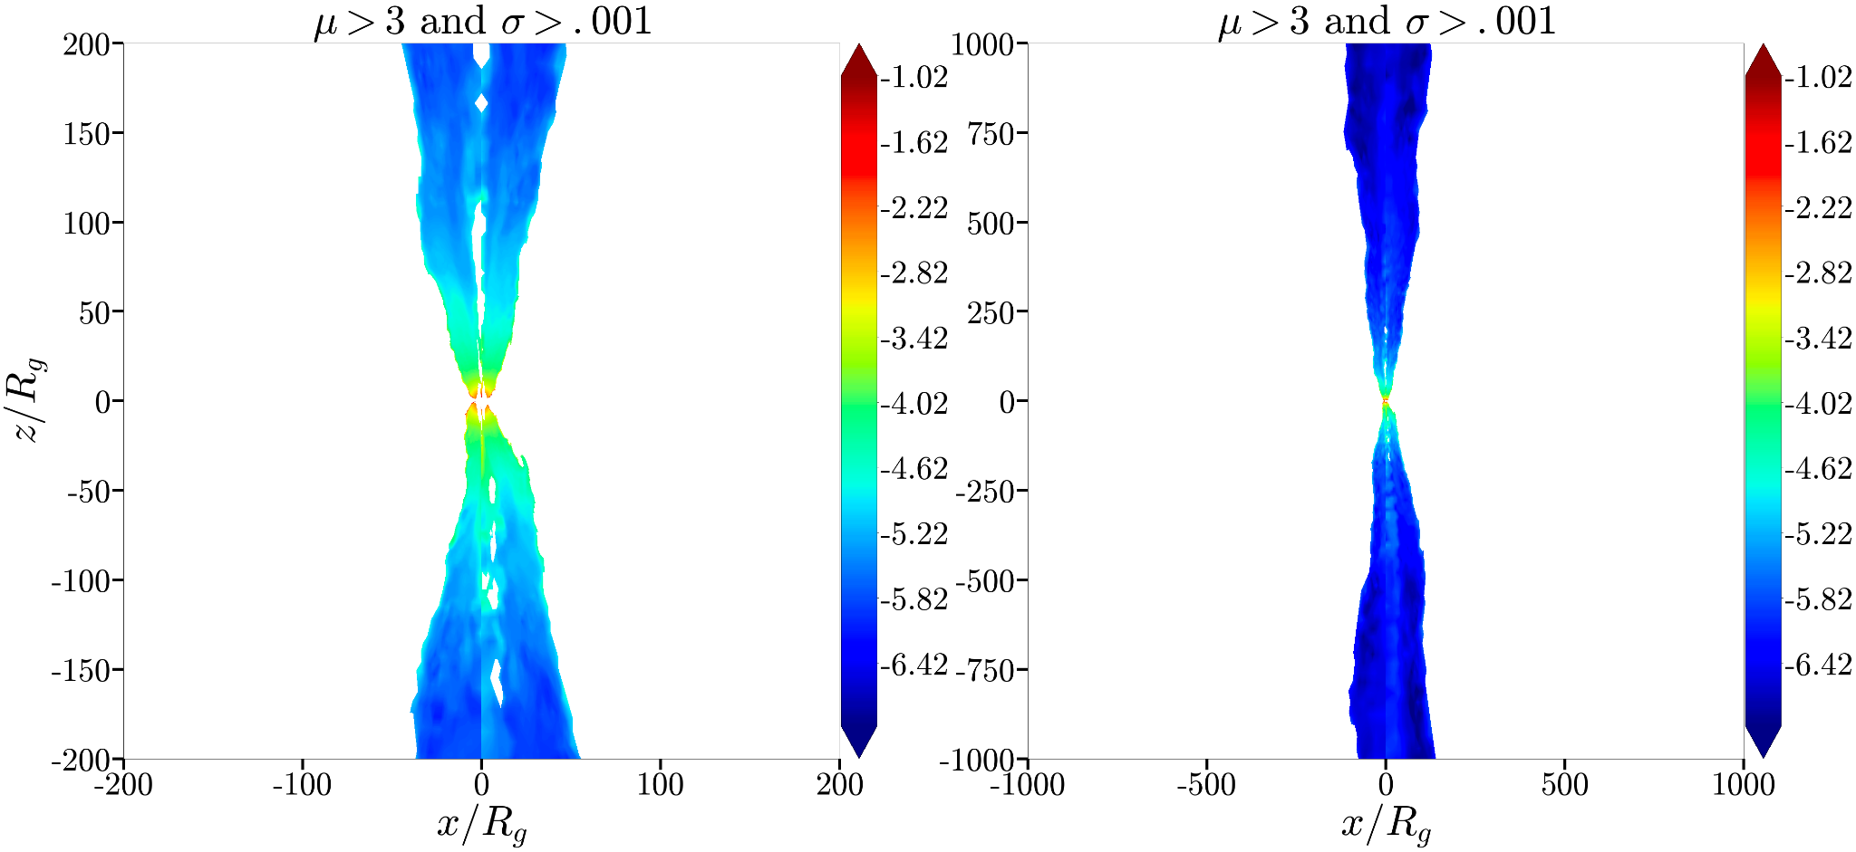
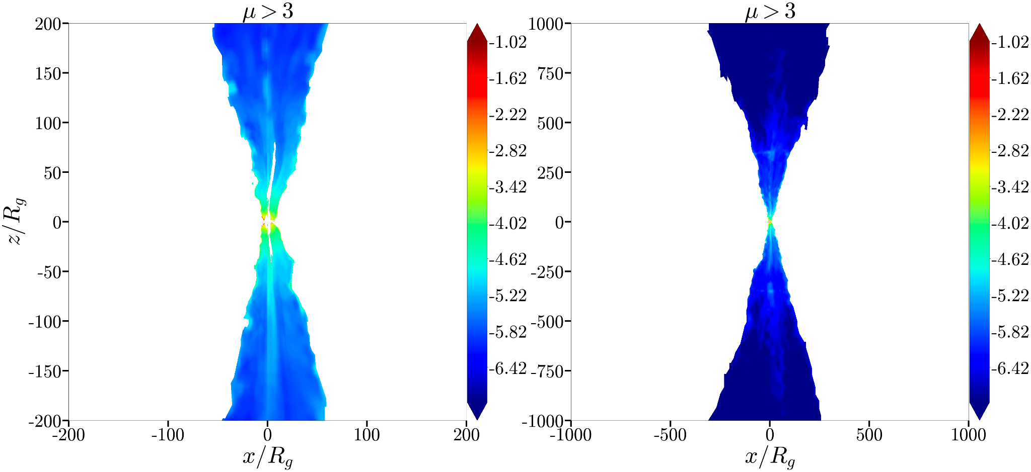
How to pick out jets
Infinite Ambient Medium
Cutoff Ambient Medium
No Ambient Medium
Max Paik

Slide 16
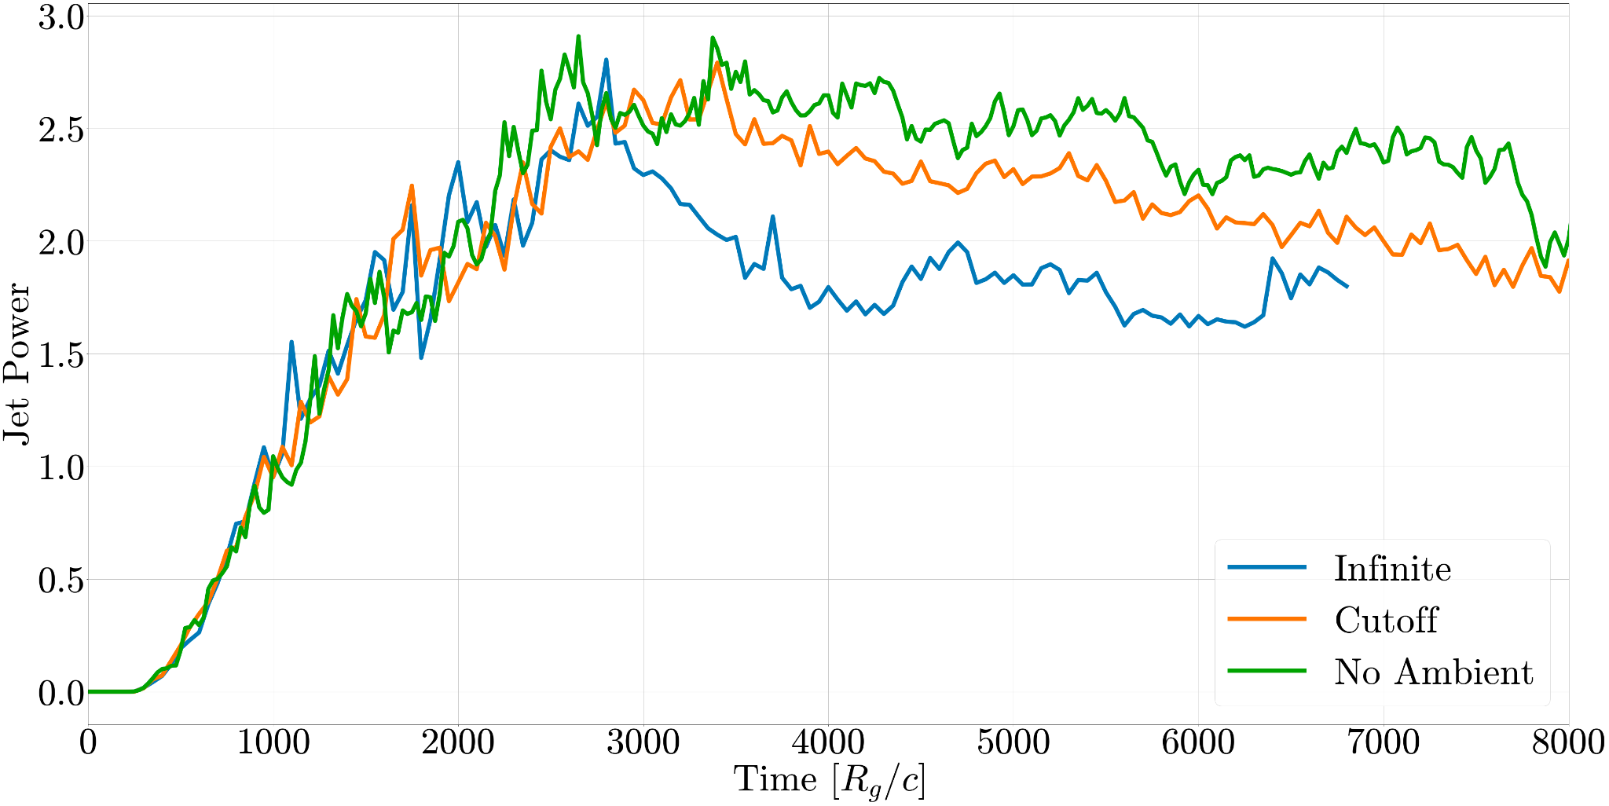
Jet power
Max Paik

Slide 17
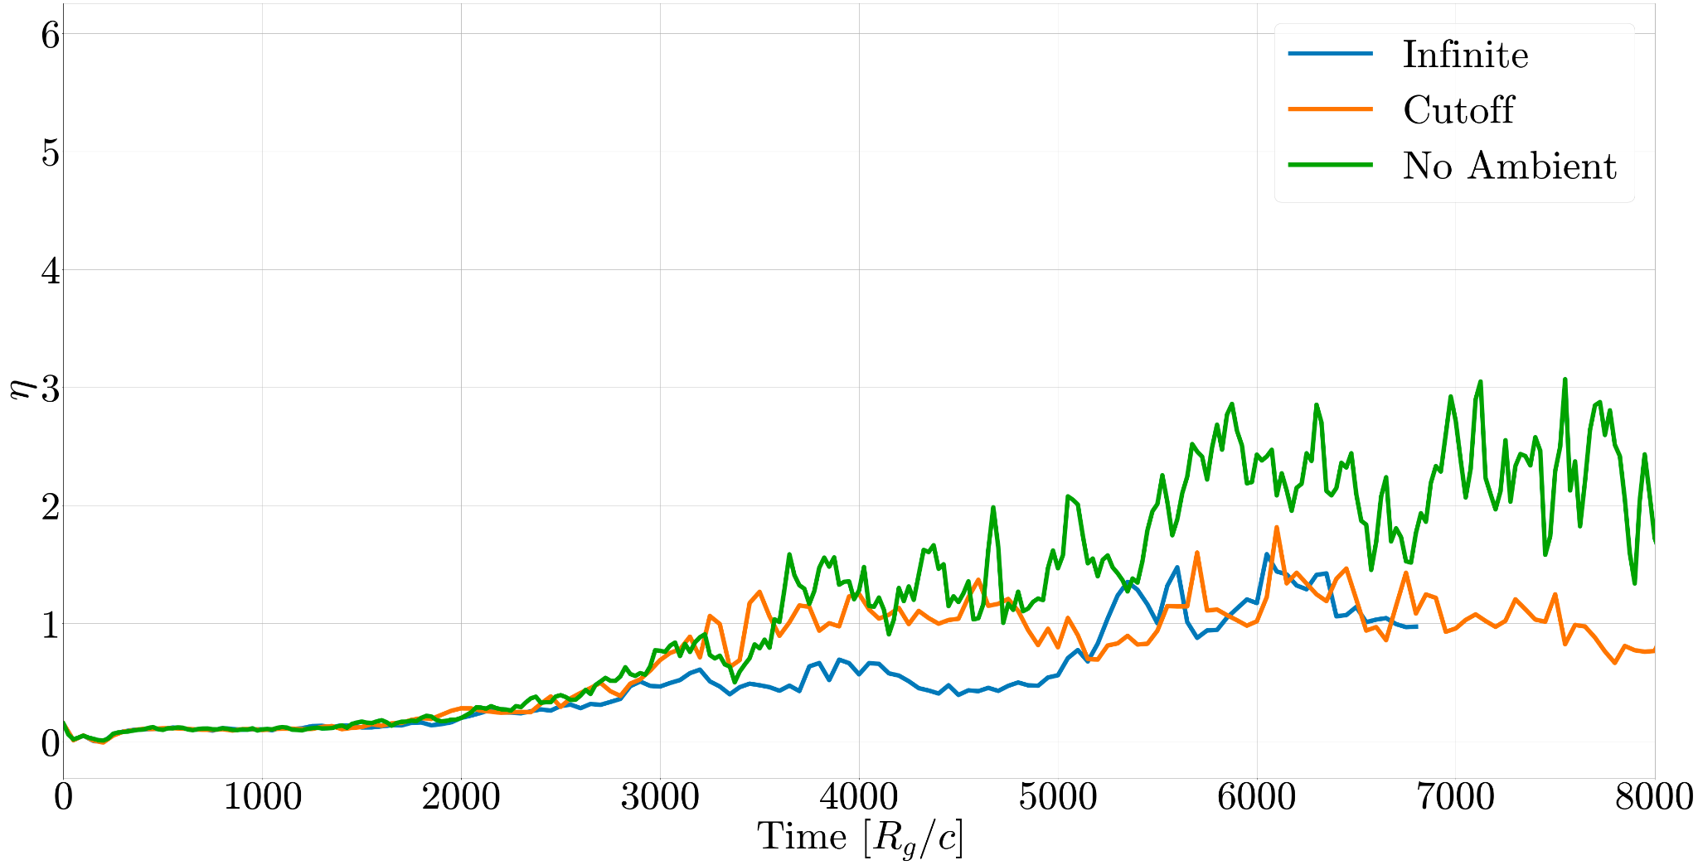
Jet efficiency
Max Paik

Slide 18
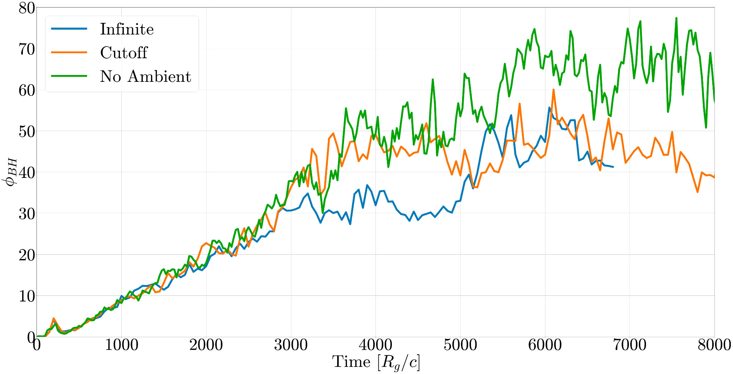
Magnetic flux on the black hole
Max Paik

Slide 19
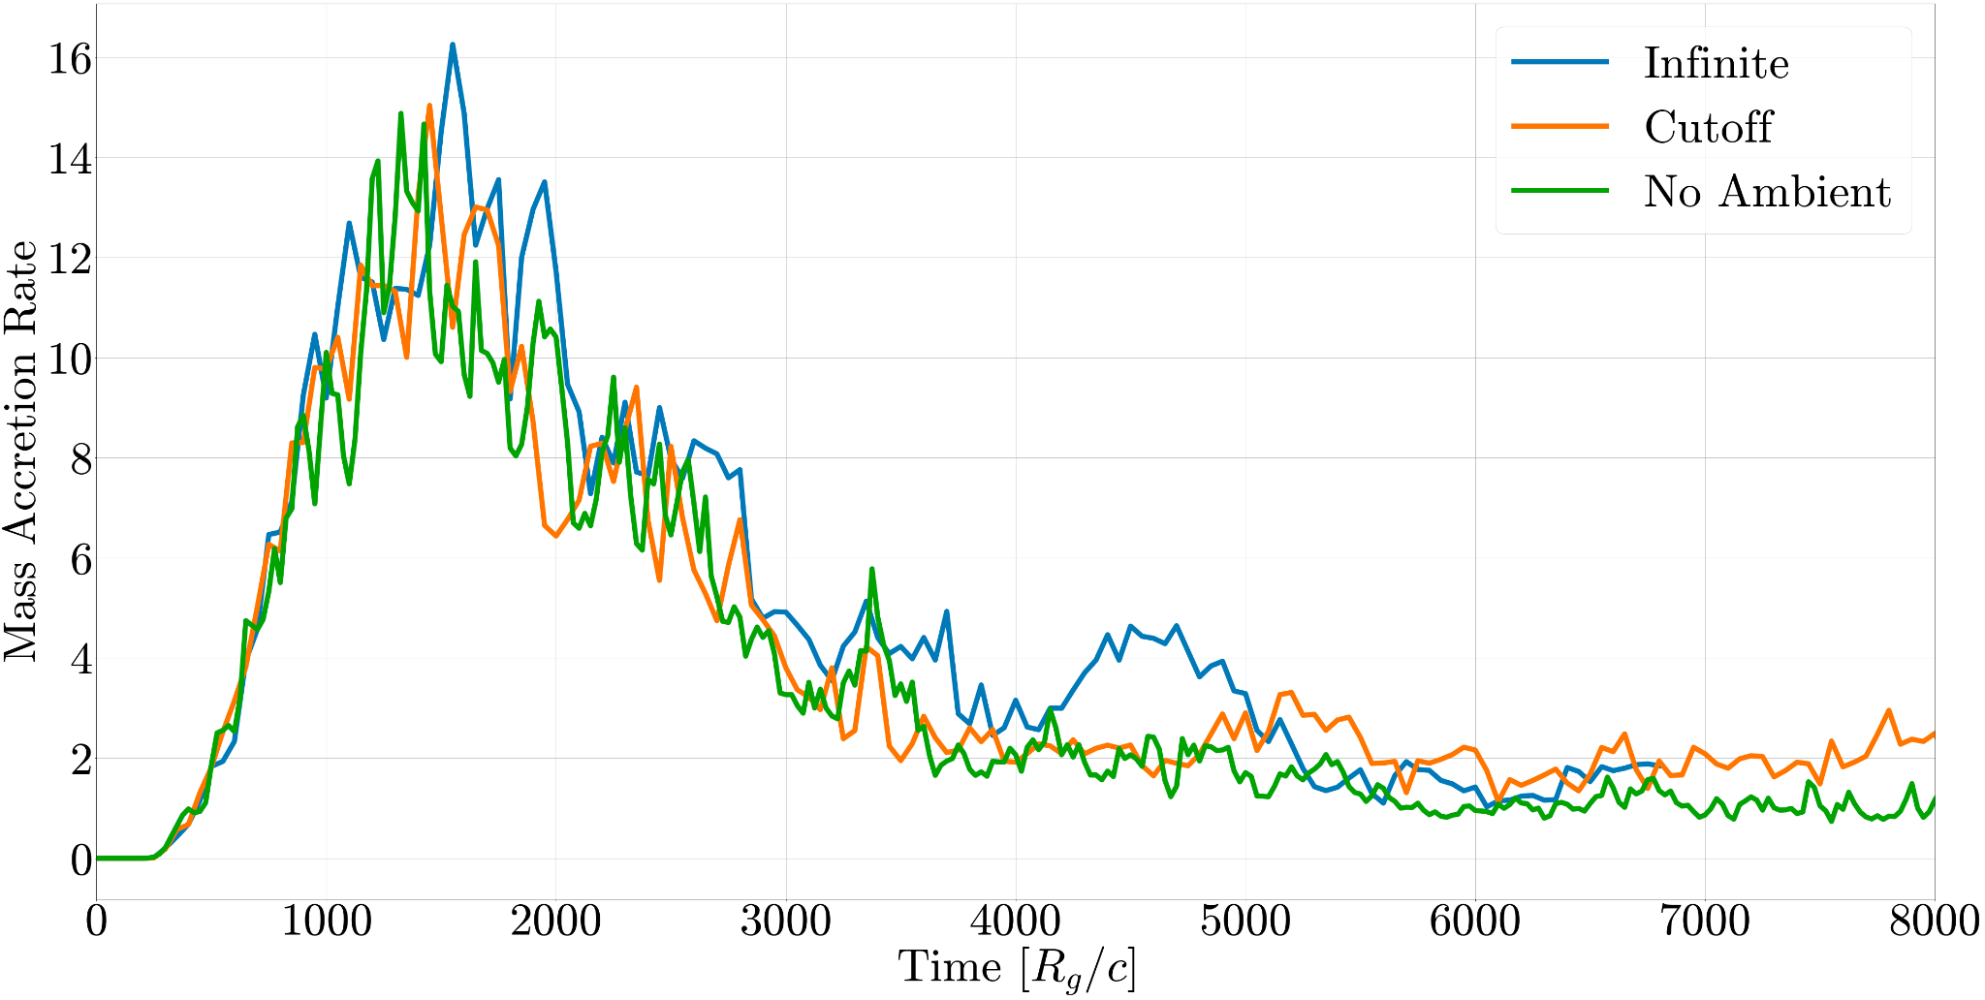
Mass accretion rate
Max Paik

Slide 20
Physical Values
R_{g} ~ 1e15 cm
R_{g} / c ~ 3e4 s
Density ~
Jet Power ~
Max Paik
Notes:
Clarify:
With respect so simulations and real systems: hot vs cold disk/jet, thin/thick disk, presence of torus, dimensionless jet power numbers, FRI vs FRII, winds of disk, bondi accretion
Pressure profile
Core interesting points and takeways, why does this matter / is it cool
Emphasize that motivation is jet transitions

